Slide 1

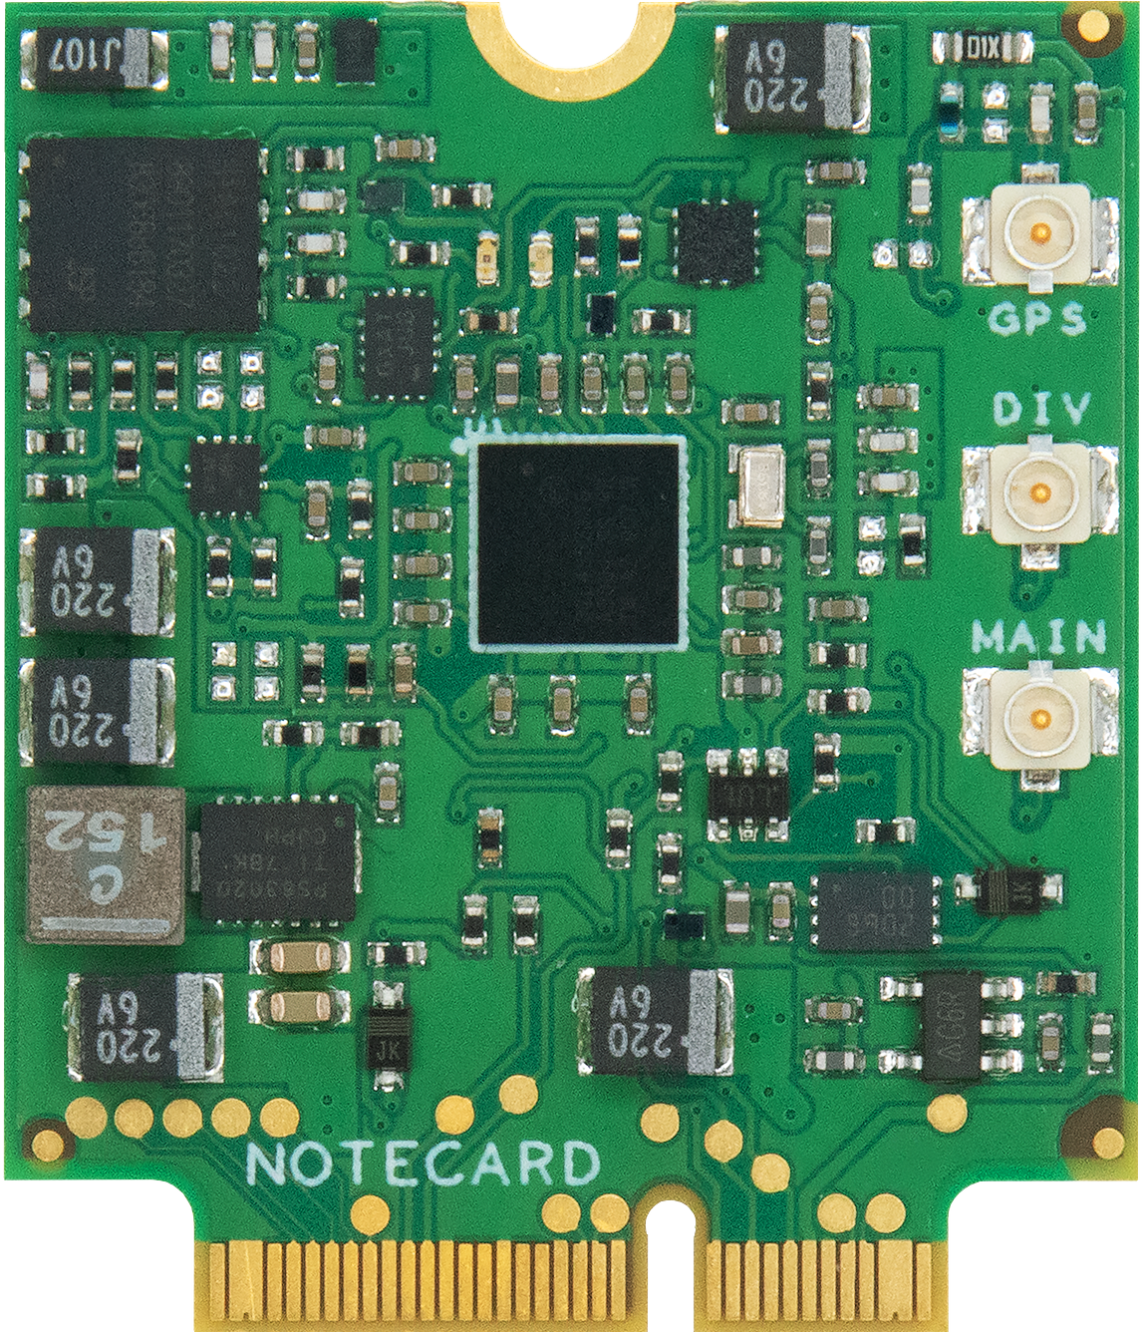
ML & The IoT

Slide 2

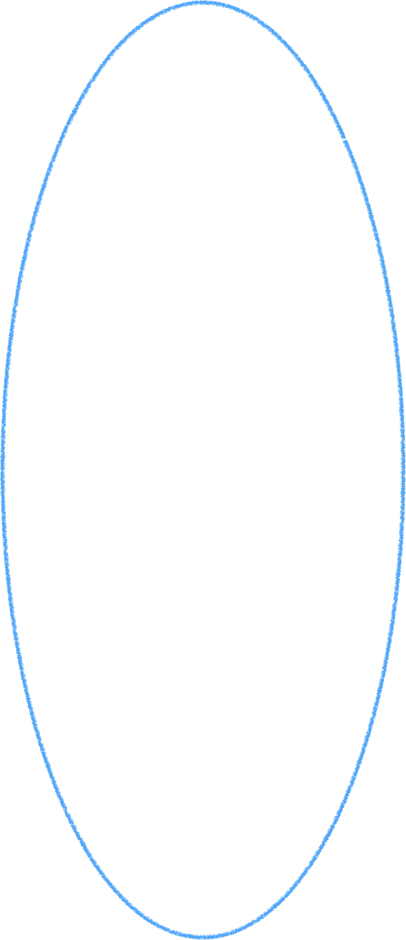









Local Development, Cloud Training and Deployment
Define Task
Real time Inference Data
Local Development
?
Collect Data
Prepare Data
Maintain, Update & Refine
Training & Validation Data
Explore
Model
Train Model
Tune
& Refine
Test & Evaluate
Deploy Model
Cloud Training & Deployment
Notes:
So far, the delineation of where things happen in the ML process has been pretty straightforward. We develop models locally with local tools, train and refine those models in the cloud, and run inference by accessing Cloud-deployed endpoints.
But one thing we haven’t discussed yet is what systems call our ML system for predictions, and where the source data for predictions come from. As it turns out this is important, because the source of these mountains of data that we created ML systems to handle and kind of the reason this whole trend is happening.
It’s also the place where the cutting edge of ML work and opportunity lies...

Slide 3



Giving Away the Point Up Front
Machine Learning is Human Teaching
Training is Meant for the Cloud
The Real Work of ML is in the IoT
Notes:
So my goal today is to convince you of three things:
Machine Learning is REALLY Human Teaching
Training is meant for the cloud
The Real Work of Machine Learning is happening in the Internet of Things

Slide 4

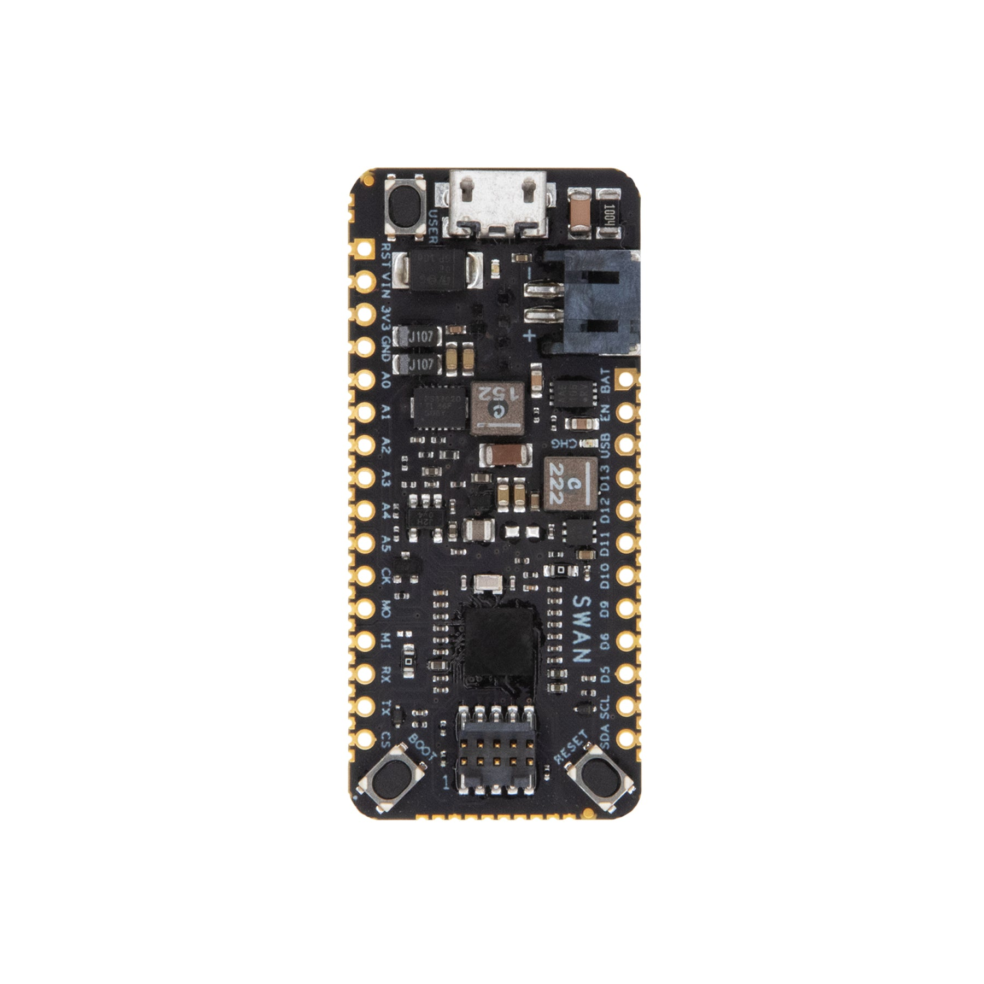
Traditional: Devices and Cloud
The Cloud
The Internet of things
“Lots of Power”
“Lots of Devices”
Notes:
First, let me dispense with some dumb terminology. Often when you hear talk about ML and IoT these days, you hear this term “edge computing,” as if there are three parts in play, the cloud, the edge and the IoT.
Traditional IoT installations looked like this. You had a network of sensors and actuators collecting data, and these devices would send all their data to the Cloud for analytics, processing and more. The gulf between the power of devices was wide. You had infinitely capable cloud-based computers, and small, constrained embedded MCUs and Single-Board Computers that couldn’t do much more than manage sensors and backhaul data to the cloud via Wi-Fi or Cellular connections.

Slide 5

The Cloud, The “Edge,” and the IoT
The Cloud
The “Edge”
The Internet of things
“Lots of Devices”
“Lots of Power”
“A Bit
of Both”
Notes:
Then, in recent years, it’s become common to introduce a third type of device into the mix. But what is the edge? A magical DMZ between the cloud and the IoT?
An “Edge” device that sits at the boundary between the IoT and the Cloud. Sometimes these devices functioned as Gateways that managed a connection to the cloud. Often, they were meant to be machines that were beefier than MCUs and SBCs so that certain types of processing could happen within the context of those local networks themselves.
And in the context of ML, it’s becoming increasingly common to talk about the edge as a place where we can push certain types of ML activities.

Slide 6
The “Edge” is the IoT
The Cloud
The “Edge”
The Internet of things
Notes:
Let’s be clear about something though: The Edge is the IoT. It’s not a third thing that sits between IoT devices and the cloud. It’s part of the IoT network. The work that happens at the edge is the work of the Internet of Things. Full stop.

Slide 7

Local Development, Cloud Training and Deployment
Define Task
Real time Inference Data
Local Development
Collect Data
Prepare Data
Maintain, Update & Refine
Training & Validation Data
Explore
Model
Train Model
Tune
& Refine
Test & Evaluate
Deploy Model
Cloud Training & Deployment
Notes:
And Edge or Devices, the IOT is the source of the data that ML needs, not only for real-time inferencing, but for constructing training and validation data in the first place.

Slide 8



Why Do ML Inferencing in the IoT?
1
2
3
Volume
Speed
Privacy
Notes:
That idea of edge devices being capable enough to handle certain kinds of tasks is critical in the context of ML. Model Training may still clearly be the sweet spot for the Cloud, but training isn’t the only part of ML that matters here. There’s also Inference, and though we tend to use the cloud for inference today, we don’t HAVE to. And there are a couple of factors contributing to an industry-wide desire to move inferencing to the edge.

Slide 9
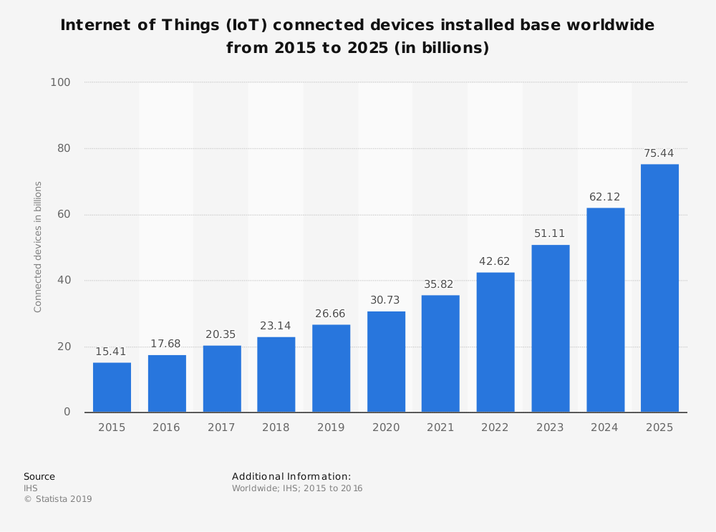
More Devices == More Data
Notes:
First, let’s talk about why there’s this desire to do inference on the edge. The first factor is the increasing number of IoT devices that are coming online every day and the volumes of data that those devices are creating. We’ve passed the point where the number of IoT devices has surpassed the number of mobile and desktop computing devices, and the growth is expected to pick up, growing at over 159% as compared to 14% growth for other computing devices.

Slide 10

Notes:
And as more and more devices come online, more data will be collected. Data that needs to be processed, forwarded and saved. We’ll continue to add devices and data, and continue to add compute capacity in the cloud. But there’s one weak link that’s probably obvious to you…

Slide 11
The Cloud may be infinite; your pipe to it is not
Notes:
And while the cloud can theoretically always scale up to account for more and more data. The pipes we use to send that data to the cloud are relatively fixed. So we can’t just keep cramming more and more data into those pipes and hope for the best.

Slide 12
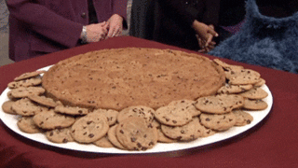
ML loves data like cookie monster loves cookies
Notes:
But ML is a data hungry field. The more data the better, right? For training yes, and we’ll continue to need to harness large datasets in the cloud to create useful models.

Slide 13
Doing Inference in the IoT means less data in the cloud
temp
rotationX
Prediction
speed
lumens
capacity
accel
Notes:
But if we don’t have to do inference in the cloud, this changes the dynamics of the data we have to send to the cloud. As I said before, with inference, we provide a volume of inputs and use the model to predict an output. Often times, that prediction is what we are really after, so if there’s a way to capture that without sending everything to the cloud, we can save ourselves time and money.

Slide 14

Inference For preventative Maintenance
Notes:
Doing inference closer to the edge also means that we can respond to the data we’re getting from IoT devices faster. This is especially important in the holy grail of IoT use cases: preventative maintenance. Consider an industrial setting with a number of machines churning away 24x7. Each machine is fitted with a connected IoT device that has an accelerometer that’s constantly monitoring vibration of key motorized components.

Slide 15
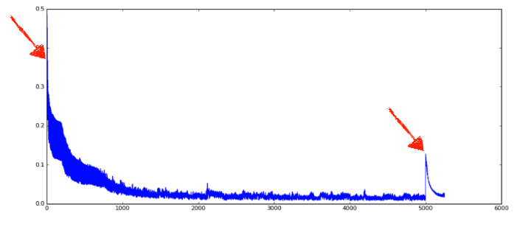
Inference For preventative Maintenance
Notes:
Let’s say that we have a trained Neural Network that knows what an out-of-variance vibration pattern looks like. One that’s indicative of a machine about to break down. Never mind for a moment that creating a model like this is a task in and of itself, let’s pretend that we have it, and we need to stream the accelerometer data we’re capturing across our fleet of 100 industrial devices and continually get a prediction of when each machine will breakdown and thus need to be serviced ahead of time.

Slide 16

There is no Cloud if the network is offline
Notes:
Streaming all of this data to the cloud is not only expensive, as we discussed before, but it's time-consuming to send the data, and wait for a response. It also means that we can’t perform predictions against our fleet if the network is offline or down for any reason.

Slide 17
Inference For preventative Maintenance
Notes:
But if we move inference to a machine in the local network, or on the edge, if you will, we get the benefit of ML with the speed of local processing.

Slide 18
IoT Inferencing == Built-In Privacy
Notes:
Finally, inference at the edge is fundamentally more secure. When we’re sending only outputs or predictions back to the cloud, and not all of the input or source data, it’s much easier to build ML and IT applications that are resilient to data manipulation and respect the privacy of the data being collected.
[Slide of Inputs needed for MV demo] → Image uploaded to cloud

Slide 19

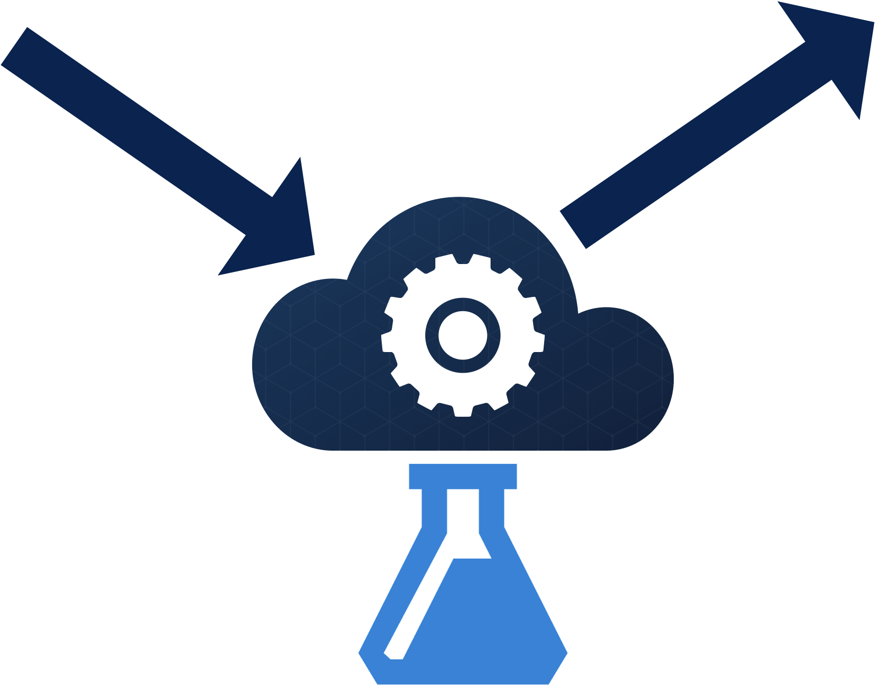

Face Detection in the Cloud
Happy
Notes:
Let’s use Machine Vision as an example here, and discuss face tracking again. Think about the earlier demo I did with the Azure Face API. In order for Cognitive Services to give me anything useful, I need to provide it with an image as an input, which means I have to transfer the file across the internet to the cloud to get an output, the thing I really want, which I can then use or store. Azure doesn’t store the image, but the very fact that I transfer it up does introduce privacy considerations to your apps.

Slide 20
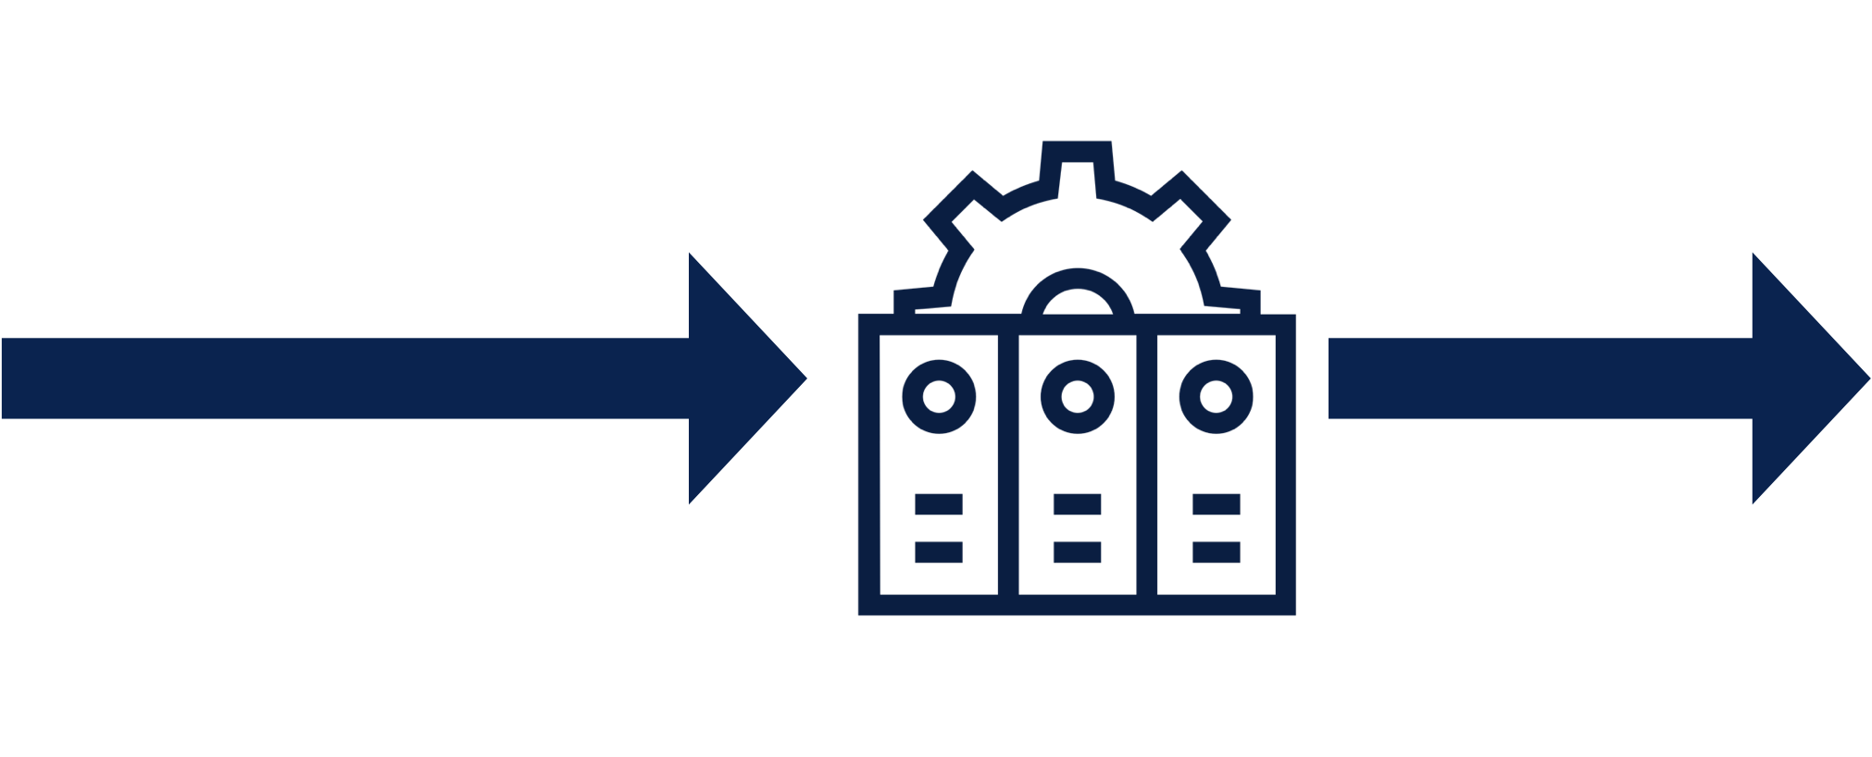
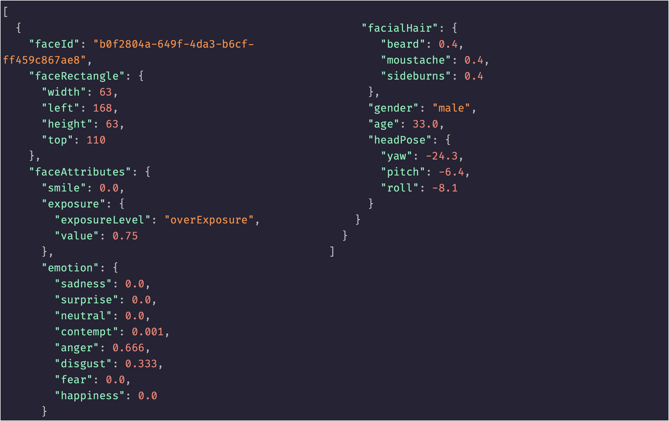
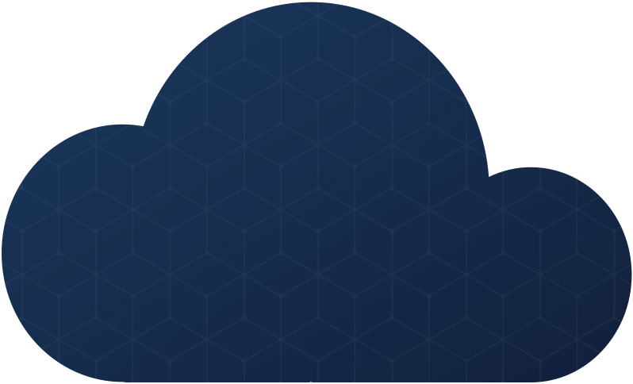
TinyML To The Rescue
Happy
Notes:
tinyML on the other hand, is a Machine Learning approach that leverages edge computing to make predictions based on captured data. That data is processed locally and is increasingly available on everything from inexpensive microcontrollers to Single-Board Computers. Model Training, which is very data-intensive still happens in the cloud, but when it comes time to analyze video, images, audio or other private data, tinyML allows you to get the predictions you want, without sacrificing privacy, or clogging your pipe with data.
Going back to the facial recognition example, with tinyML, you can capture the image and process it locally, sending only the data you care about, the prediction to the cloud, while the raw telemetry stays private or can be deleted.
With local facial recognition, we send the end-result of inferencing, which is much more privacy-preserving and uses less of our data-pipe

Slide 21
The Increasing Role of the IoT in ML
1
2
Collection & Coordination on Devices
ML Inferencing on Microcontrollers!
Notes:
For this last part of my talk, I want to talk about two ways that the IoT matters a great deal in this world of ML. First, I’ll talk about the role that IoT devices play in collection and coordination with edge inferencing devices like the coral. And second, I want to show how its becoming increasingly possible to do ML inferencing on small, low-powered MCUs as well!

Slide 22
ML data doesn’t come from the cloud, or the edge…
It comes from the IoT
Notes:
First, this might seem obvious to all of us, but I want to underscore it here because in a lot of the interest around ML in the cloud and the edge, there’s never a lot or talk about where the data comes from. Often, models appear out of thin air, and the data we need for inference is just there.
But the reality is that there is no Machine Learning without data, and there is no ML at the edge without IoT devices like Microcontrollers, and the devices they work with.

Slide 23

IoT Devices Sense and share
Notes:
Even with the rise of edge ML, the IoT still plays a huge role in enabling edge ML scenarios to work. MCUs and their sensors are still the source of data that may be deferred to the edge SBC for inference.

Slide 24
IoT Devices Take Action
Notes:
And once inference happens, if a response is needed in the network itself, IoT devices are the ones that take action. Remember my industrial example above? Let’s assume that we have a single machine that the edge device notices is out of variance. In most cases, our edge device will detect that variance and fire an alert letting a human know that the machine should be serviced. But when working in concert with IoT devices, it’s also possible for the IoT devices themselves to take action, putting the machine in standby mode until a technician arrives, or setting firmware configurations that modify the operating mode of the machine. With the insight that an edge ML device can provide, we can program our IoT applications to become more than passive, and take action.

Slide 25
TensorFlow Lite Micro
Notes:
Over the last year, the TensorFlow team has been hard at work creating support for Microcontrollers to TensorFlow Lite, which has typically supported inferencing on mobile devices. With this support, its now possible to run ML inferencing on low-power devices that have a fraction of RAM and flash as our phones do.

Slide 26
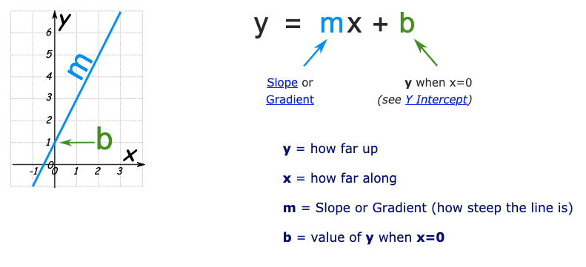
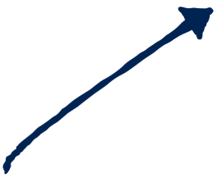


Building an MCU-friendly Model
export_dir = 'saved_model/'
tf.saved_model.save(model, export_dir)
# Convert the model to an in-memory object
converter = tf.lite.TFLiteConverter.from_saved_model(export_dir)
tflite_model = converter.convert()
# Write to a file
tflite_model_file = pathlib.Path('linear_regression_model.tflite')
tflite_model_file.write_bytes(tflite_model)
2) Convert to TensorFow Lite
1) Build and Train the model
x = [-1, 0, 1, 2, 3, 4]
y = [-3, -1, 1, 3, 5, 7]
model = tf.keras.models.Sequential([
tf.keras.layers.Dense(units=1, input_shape=[1])
])
model.compile(optimizer='sgd', loss='mean_squared_error')
model.fit(x, y, epochs=200, verbose=1)
3) Create a C-Array Representation of the model
unsigned char g_linear_regresion_model_data[] = {
0x1c, 0x00, 0x00, 0x00, 0x54, 0x46, 0x4c, 0x33, 0x00,
0x00, 0x12, 0x00, 0x1c, 0x00, 0x04, 0x00, 0x08, 0x00,
0x0c, 0x00, 0x10, 0x00, 0x14, 0x00, 0x00, 0x00, 0x18,
0x00, 0x12, 0x00, 0x00, 0x00, 0x03, 0x00, 0x00, 0x00,
// Many more lines here
};
unsigned int g_linear_regresion_model_data_len = 780;
Notes:
Using TFLite for Microcontrollers is easy, and it lets you leverage your existing ML skills, while adding easy inferencing features in a C/C++-friendly set of libraries. You start by building a model just as you would for any other device. Then you convert the model to TF-lite and export it to a C-Array, which allows the model to be loaded in environments where there is no filesystem present, like an MCU.
In this example, we’re doing something trivial to keep it simple. In a real-world use-case, you model may be a lot more complex.

Slide 27
Building a TFLite Model & Inferencing on Swan
Demo
Notes:
It turns out the Azure Face API has an emotion detection component, let’s look at that now

